Slide 1
OMNIFY ANALYSIS
Google Ads Data

Slide 2
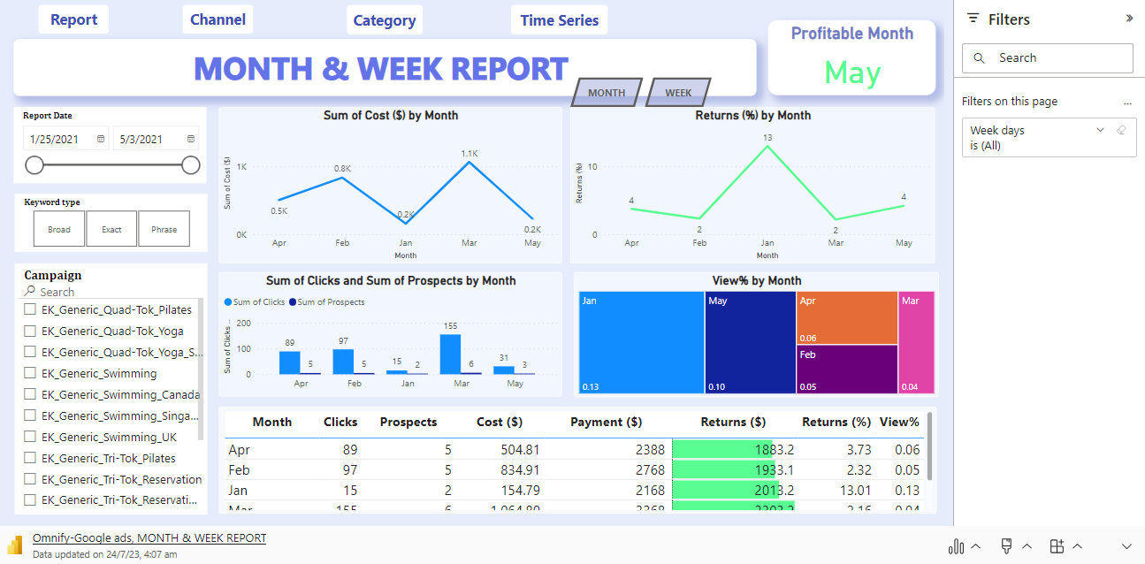
Link : https://app.powerbi.com/reportEmbed?reportId=85723fc5-db6a-4be3-ba4a-0e3b0a0d5299&autoAuth=true&ctid=a90703de-3b25-4520-a41b-56a6f50dff03

Slide 3
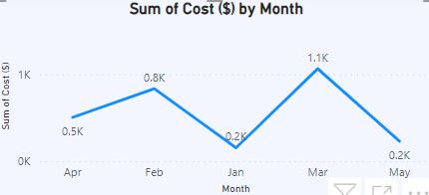
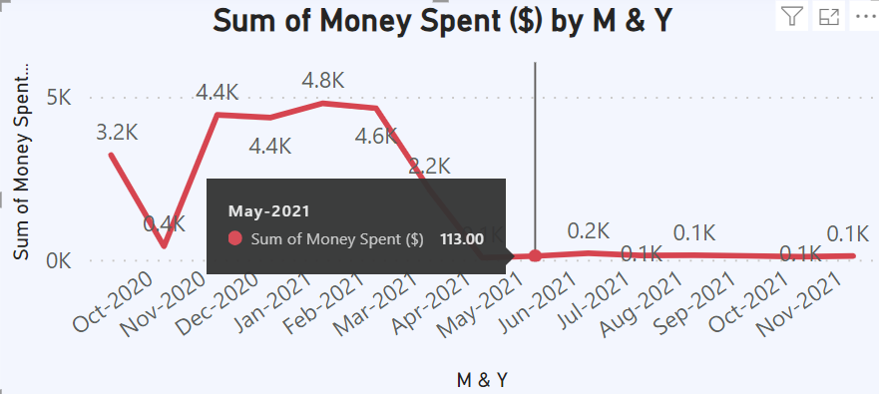
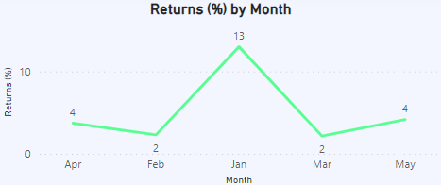
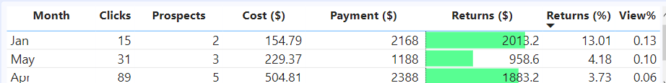
Create a combined report with all key metrics (esp: Spends and Returns %) in a weekly and monthly format. Decide the number of data fields you would like to showcase here.
January is the most profitable month,
With a cost of $ 154.79 and
Returns of $ 2013.2,
Resulting in a Return% of 13.01% and
A view% of 0.13.

Slide 4
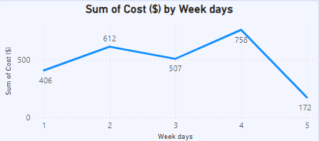
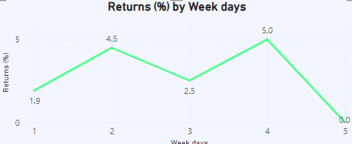
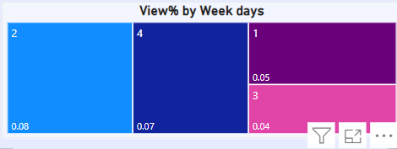
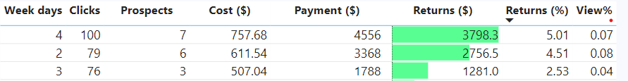
II. Fourth week is the profitable week ,
With a cost of $ 757.68 and
Returns of $ 3798.3,
Resulting in a Return% of 5.01% and
A view% of 0.07.

Slide 5
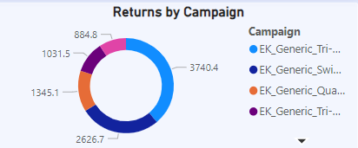
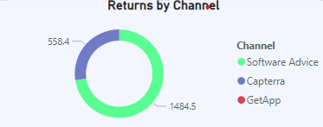
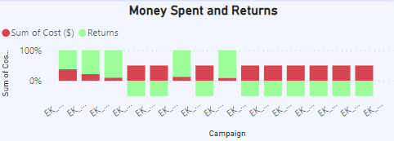
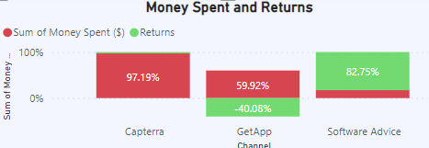
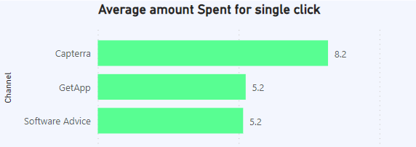
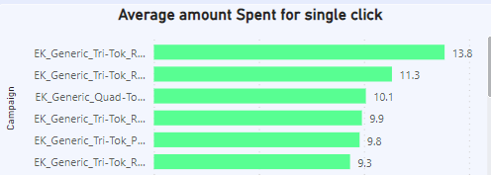
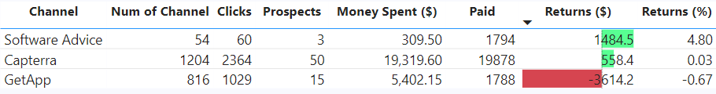
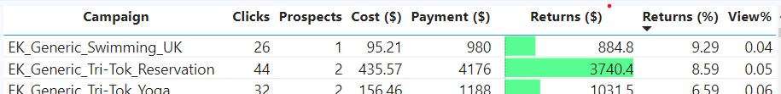
2. Which is the most profitable Campaign
EK Generic Swimming UK is the most profitable campaign with a
By Spending the amount of $ 95.21
Returns of $ 884.8
Resulting in a Return% of 9.29% and
A view% of 0.04
* Even though EK Generic Tri – Tok Reservation has higher the Return
value, the value of Returns($) is lower compare to EK Generic
Swimming UK

Slide 6
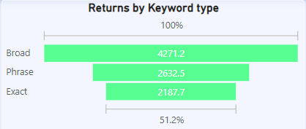
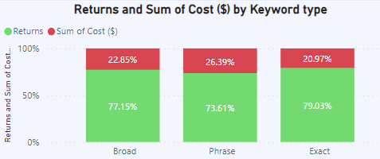
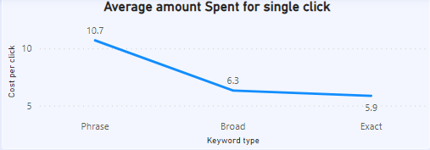
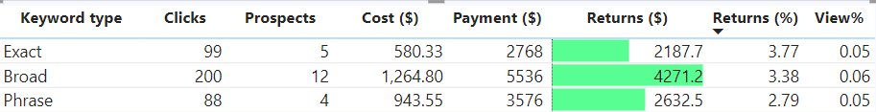
3. Which category is most profitable
Exact is the most profitable campaign with a
By Spending the amount of $ 580.33
Returns of $ 2187.7
Resulting in a Return% of 3.77% and
A view% of 0.05
* Even though Broad has higher the Return % , the value of Returns($) is
lower compare to Exact.

Slide 7
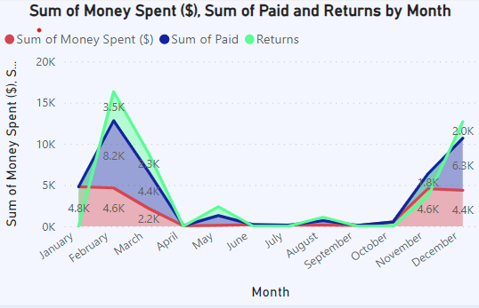
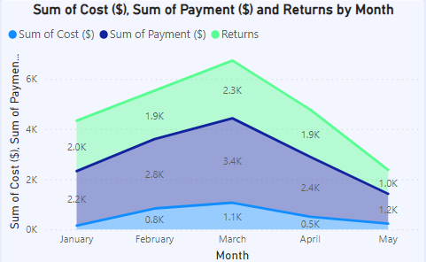
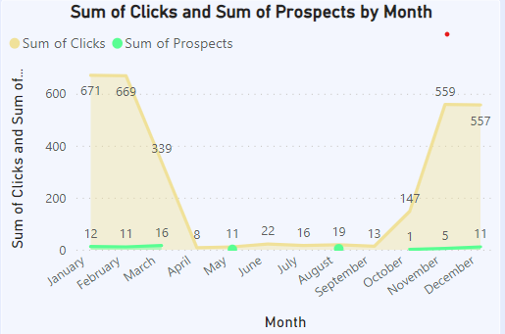
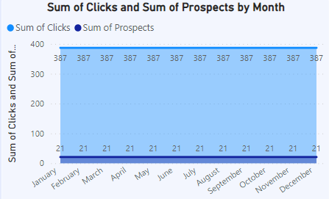
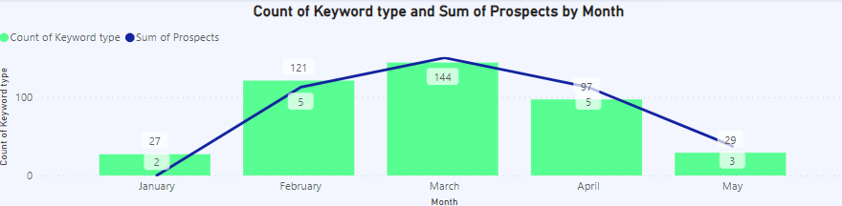
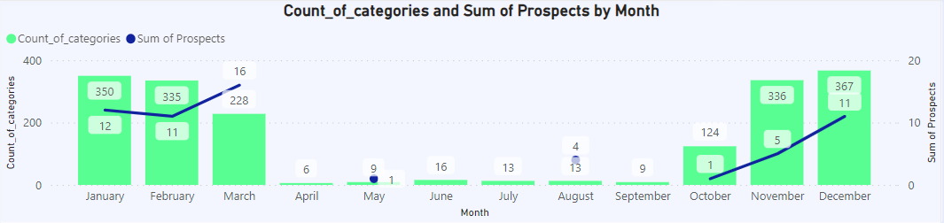
4. Look for insights by analyzing data points on Time Series Graphs
February is the highly active month with a
By Spending the amount of $ 1.1k
Returns of $ 2.3k
With Prospects of 21 over 387 clicks

Slide 8
Important Calculations :
Cost per click : Amount spent for single click calculated by dividing the money spent by the people view the ad
DIVIDE(SUM('Google_Ads_Data'[Cost ($)]), SUM('Google_Ads_Data'[Clicks]))
Returns : It is the profit percentage calculated by finding the Difference between the money earned and the money spent
(SUM(Google_Ads_Data[Payment ($)]))-(SUM(Google_Ads_Data[Cost ($)]))
Returns (%) : It is the profit percentage calculated by finding the difference between the money earned and the money spent, and then dividing it by the money spent.
(SUM(Google_Ads_Data[Payment ($)]) - SUM(Google_Ads_Data[Cost ($)])) / SUM(Google_Ads_Data[Cost($)])
View% : It is the percentage of calculated by finding the difference between the number for people paid for the product and the people view the ad and then dividing it by the people view the ad then added with 1.
(SUM(Google_Ads_Data[Prospects]) - SUM('Google_Ads_Data'[Clicks])) / SUM(Google_Ads_Data[Clicks])+1

Slide 9
Thank You

